Slide 1
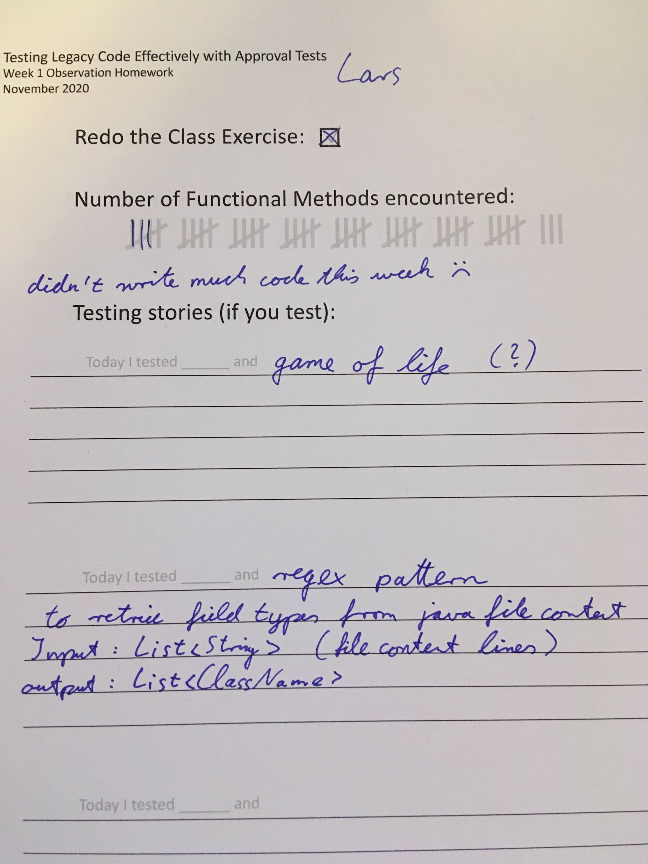
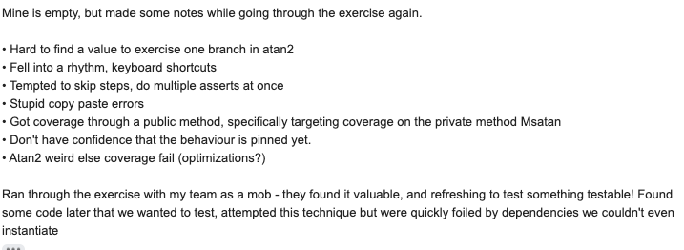
Today I tested __TrigMath.sin()____ and got different than expected results based on the C++ version. The values sent into the function needed to be changed, possibly due to the absence of a Java APPROX equivalent function in C++.
Today I tested TrigMatch.cos()_____ and using all of the inputs used in the C++ version, all tests passed.
Today I tested _TrigMath.cos_____ and inputs used in the C++ version resulted in the test passing.

